Slide 1

29 Gorffennaf 2026 | 29 July 2026
Cyfarfod Cyffredinol Blynyddol
Annual General Meeting

Slide 2
Croeso i'n Cyfarfod Cyffredinol Blynyddol 2025/26
Welcome to our Annual General Meeting 2025/26
Croeso a chyflwyniad gan y Cadeirydd, Dyfed Edwards a'r Prif Weithredwr, Carol Shillabeer
Cyflwyniadau gan dimau a gwasanaethau PBC
Diben y Cyfarfod Cyffredinol Blynyddol ac eitemau ar yr agenda
Introduction and welcome from the Chair, Dyfed Edwards and Chief Executive, Carol Shillabeer
Presentations from BCU teams and services
Purpose of the Annual General Meeting and agenda items

Slide 3
Pwy ydym ni
Who we are
Rydym ni'n gyfrifol am ddarparu gwasanaethau gofal iechyd i fwy na 700,000 o bobl ledled chwe sir Gogledd Cymru. Mae hyn yn cynnwys iechyd sylfaenol a chymunedol, ac iechyd meddwl yn ogystal â gwasanaethau ysbytai acíwt.
Rydym yn gweithredu tri phrif ysbyty ac 17 ysbyty cymunedol, ynghyd â rhwydwaith o ganolfannau iechyd, clinigau, unedau iechyd meddwl a chanolfanau timau cymunedol. Rydym hefyd yn darparu gwasanaethau gofal iechyd carchar i CEF Berwyn, Wrecsam.
Mae'r Bwrdd Iechyd yn cydlynu gwaith 96 o bractisau meddygon teulu, yn ogystal â gwasanaethau'r GIG sy'n cael eu darparu gan 83 o bractisau deintyddol ac orthodontig, 69 o bractisau optometreg ac optegwyr a 147 o fferyllfeydd yng Ngogledd Cymru.
Rydym ni hefyd yn gyfrifol, trwy bartneriaeth, am wella iechyd a lles pobl leol drwy weithgareddau megis ein rhaglenni brechu llwyddiannus a gwasanaethau iechyd ar gyfer ysgolion.
We are responsible for the delivery of health care services to more than 700,000 people across the six counties of North Wales. This includes primary, community and mental health as well as acute hospital services.
We operate three main hospitals and 17 community hospitals, along with a network of health centres, clinics, mental health units and community team bases, and also deliver prison health care services within HMP Berwyn, Wrexham.
The Health Board coordinates the work of 96 GP practices, and NHS services provided by 83 dental and orthodontic practices, 69 optometry practices and opticians and 144 pharmacies in North Wales.
We are also responsible, in partnership, for improving the health and wellbeing of local people through activities such as our successful vaccination programmes and school health services.

Slide 4
2025/26 – Heriau
2025/26 – Challenges
Mae hon wedi bod yn flwyddyn o newid mawr i'r sefydliad. Mae wedi bod yn flwyddyn lle rydym ni wedi parhau i weld gwelliannau, ond rydym yn dal i wynebu heriau sylweddol, megis:
Lleihau nifer y cleifion sy'n aros yn hir am driniaeth
Gwella mynediad at ofal brys a gofal mewn argyfwng
Buddsoddi mewn adeiladau a thechnoleg
Rheoli cyllid
Cynaliadwyedd hirdymor gwasanaethau
This has been a year of great change for the organisation. It has been a year where we have continued to see improvement, but still face significant challenges, such as:
Reducing the number of patients waiting a long time for treatment
Improving access to urgent and emergency care
Investment in buildings and technology
Managing finances
Long term sustainability of services

Slide 5
2025/26 – Llwyddiannau
2025/26 – Successes
Er gwaethaf yr heriau, rydym ni'n gwybod bod ein staff yn mynd ati bob dydd i wneud pethau gwych i gynorthwyo cymunedau ledled Gogledd Cymru a chynorthwyo'i gilydd. Mae rhai o uchafbwyntiau’r flwyddyn yn cynnwys:
Gostyngiad o 63 y cant yn nifer y cleifion sy'n aros mwy na dwy flynedd am driniaeth (o 5,819 i 2,161). a dileu pob amser aros o fwy na 208 wythnos. Lleihaodd nifer y bobl a oedd yn aros mwy na dwy flynedd am eu hapwyntiad cleifion allanol cyntaf o 49,600 (Gorffennaf 2025) i 2,340 (Mehefin 2026).
Gostyngodd nifer y bobl a oedd yn aros yn hirach na blwyddyn am eu hapwyntiad cleifion allanol cyntaf o tua 32,000 (Awst 2025), i tua 5,000 (Mehefin 2026) ochr yn ochr â pherfformiad diagnostig sy'n sylweddol well. At ei gilydd, mae'r gwelliant hwn yn golygu bod cleifion yn cael eu gweld ac yn cael y gofal sydd ei angen arnynt yn gyflymach.
Despite the challenges, we know that every day our staff do amazing things to support our communities across North Wales and each other. Some of the highlights of the year include:
A 63 per cent reduction in patients waiting more than two years for treatment and elimination of all waits of more than 208 weeks (from 5,819 to 2,161). The number of people waiting more than two years for their first outpatient appointment was reduced from 49,600 (July 2025) to 2,340 (June 2026).
The number of people waiting longer than a year for their first outpatient appointment reduced from about 32,000 (August 2025), down to about 5,000 (June 2026) alongside a significantly improved diagnostic performance. Altogether this improvement means patients are being seen and getting the care they need more quickly.

Slide 6
2025/26 – Llwyddiannau
2025/26 – Successes
Lansio Rhaglen Meistr mewn Fferylliaeth newydd yn Ysgol Feddygol Gogledd Cymru, a ddatblygwyd mewn partneriaeth â Phrifysgol Bangor. Mae'n garreg filltir bwysig arall i Ysgol Feddygol Gogledd Cymru.
Parhau i fuddsoddi a chryfhau gwasanaethau ar draws ein cymunedau, fel gwasanaethau fferylliaeth, deintyddiaeth ac optometreg.
Cryfhau a ffurfioli cynllunio strategol yn sylweddol, a fydd yn cyflawni strategaeth 10 mlynedd a Strategaeth Gwasanaethau Clinigol i wella iechyd a lles poblogaeth Gogledd Cymru.
Cryhau trefniadau llywodraethiant, rheoli risg a rheoli ansawdd.
The launch of a new Master of Pharmacy Programme at the North Wales Medical School, which has been developed in partnership with Bangor University and is another major milestone for the North Wales Medical School.
Continued investment and strengthening of services across our communities, such pharmacy, dentistry and optometry services.
Significantly strengthened and formalised strategic planning arrangements, which will deliver a 10-year strategy and Clinical Services Strategy to improve the health and wellbeing of the population of North Wales.
Strengthened governance, risk management and quality management arrangements.

Slide 7
2025/26 – Llwyddiannau
2025/26 – Successes
Parhau i fuddsoddi mewn cyfleusterau newydd gyda Chanolfan Lawfeddygol Gogledd Cymru yn Ysbyty Llandudno yn agosáu at ei chwblhau a chynlluniau'n cael eu cyhoeddi ar gyfer ailddatblygu Ysbyty Brenhinol Alexandra yn y Rhyl.
Trawsnewid digidol gyda chyflwyno system ragnodi electronig newydd a systemau digidol newydd ar gyfer cofnodion cleifion.
Continued investment in new facilities with the North Wales Surgical Hub at Llandudno Hospital moving closer to completion and plans being announced for the redevelopment of the Royal Alexandra Hospital in Rhyl.
Digital transformation with the rollout of a new electronic prescribing system and new digital patient record systems.

Slide 8
Y camau nesaf
Next steps
Gan edrych ymlaen at 2026/27, mae ein ffocws ar adeiladu ar y gwaith cychwynnol a'r gwaith cyflawni cynnar a wnaed hyd yma, a chyflymu’r broses o gyflawni newid i’r gwasanaethau'r rheng flaen gan barhau i greu sefydliad cynaliadwy yn y tymor hir. Mae rhai darnau o waith hollbwysig a fydd yn hanfodol i gyflawni hyn yn cynnwys:
Gwella mynediad at wasanaethau, lleihau'r amser y mae pobl yn aros am driniaeth boed wedi'i chynllunio neu mewn argyfwng.
Gwella diogelwch cleifion a lleihau niwed y gellir ei osgoi.
Cryfhau sefydlogrwydd y gweithlu a'r gallu i arwain.
Looking ahead to 2026/27, our focus is on building upon the foundational and early delivery work to date and to accelerate delivery of change to front line services, whilst continuing to build a sustainable organisation for the long-term. There are some critical pieces of work that will be fundamental to achieving this, which include:
Improving access to services, reducing the time people wait for treatment whether planned or in an emergency.
Improving patient safety and reducing avoidable harm.
Strengthening workforce stability and leadership capacity.

Slide 9
Y camau nesaf
Next steps
Cryfhau'r model o ofal sylfaenol a chymunedol integredig ledled Gogledd Cymru drwy'r rhaglen drawsnewid Cymunedol o’r Cychwyn.
Canolbwyntio ar raglenni allweddol i wella iechyd ledled ein cymunedau.
Parhau i gefnogi arloesedd digidol, gan gynnwys datblygu cofnodion cleifion electronig ac ap GIG Cymru.
Strengthen the model of integrated primary and community care across North Wales through the Community by Design transformation programme.
Focus on key health improvement programmes across our communities.
Continue to support digital innovation, including the development of electronic patient records and the NHS Wales app.

Slide 10
Cyfarfod Cyffredinol Blynyddol:
Adroddiad Ansawdd Blynyddol, 2025-2026
Annual General Meeting (AGM):
Annual Quality Report 2025-2026

Slide 11
Cyflawni Ansawdd, Diogelwch a Phrofiadau Gwell Ledled Gogledd Cymru
Delivering Better Quality, Safety and Experience Across North Wales
Neges Allweddol:
Yn ystod 2025/26, bu’r ffocws cyffredinol ar gryfhau ansawdd, diogelwch, llywodraethu a dysgu sefydliadol. Mae cynnydd wedi digwydd tra bod y Bwrdd Iechyd yn dal i weithredu o dan Fesurau Arbennig
Y prif risg o ran ansawdd:
Mynediad prydlon i gleifion at ofal diogel ac effeithiol
Prif feysydd y gwelliannau:
Gostyngiad sylweddol mewn arosiadau hir am ofal
Mynediad gwell at ofal iechyd meddwl i oedolion a phlant
Cyflawni gofynion y datganiad Ansawdd Gwasanaethau Mamolaeth a’r Newydd-anedig ac agor Hwb Iechyd Merched
Gwella galluoedd digidol
Gwelliannau o ran llywodraethu ansawdd
Gwrando ar gleifion, staff a chymunedau er mwyn llywio gwasanaethau’r dyfodol
Key Message:
During 2025/26 the overall focus has been on strengthening quality, safety, governance and organisational learning. Progress has been made whilst the Health Board is still operating in Special Measures
Main quality risk:
Timely patient access to safe and effective care
Headline areas of improvement:
Significant reduction in long waits for care
Improved access to mental health care for adults and children
Delivering the requirements of the Maternity and Neonatal Quality statement and opening a Women’s Health Hub
Enhancing digital capability
Improvements in quality governance
Listening to patients, staff and communities to shape future services

Slide 12
Gostyngiad sylweddol mewn arosiadau am ofal
Significant reduction in waits for care
Gostyngiad yn yr amser a ddisgwylir am ofal wedi’i gynllunio
Trawsnewid y llwybrau brys lle’r amheuir canser
  Teledermosgopi i helpu i frysbennu a chyflymu mynediad bobl sydd â chyflyrau croen
  Nyrsys arbenigol yn brysbennu'n syth i brofion yn gwella mynediad i'r sawl sydd â chanser y coluddyn tebygol
  Defnyddio endosgopi sbwng llai ymwthiol pan fo'n briodol
  Nyrsys wedi'u hyfforddi mewn biopsïau o’r prostad i gyflymu diagnosio canser
  Dau beiriant radiotherapi newydd yng Nghanolfan Canser Gogledd Cymru
  Agor Canolfan Maggie’s yn safle Glan Clwyd
Reduction in wait for planned care
Transformation of pathways for urgent suspected cancer
  Teledermoscopy to help triage and speed up access for those with skin conditions
  Specialist nurses triaging straight to test improving access for those with suspected bowel cancer
  Use of less invasive sponge endoscopy when appropriate
  Nurses trained in prostate biopsy to speed up diagnosis of cancer
  Two new radiotherapy machines at North Wales Cancer Centre
  Maggie’s Centre opened on Glan Clwyd site

Slide 13
Gwelliannau i Wasanaethau Iechyd Meddwl
Mental Health improvements
Gwella amseroedd asesiadau a thriniaethau ar gyfer gwasanaethau iechyd meddwl oedolion a phlant; cyflawni targedau cenedlaethol erbyn mis Mawrth 2026
Cwblhawyd rhaglen waith fawr i sicrhau bod Adolygiad Coleg Brenhinol y Seiciatwyr yn cael ei weithredu gan gydweithio'n agos â'r Grŵp Cynghori Arbenigol i sicrhau camau gweithredu ystyrlon er budd defnyddwyr gwasanaethau
Gostyngiad sylweddol yn nifer y cleifion a leolir mewn gwelyau 'y tu allan i'r ardal'
Y Bwrdd Iechyd yn cael ei ddewis i redeg gwasanaeth cymorth gamblo ledled Cymru
Improving assessment and treatment times for adult and child mental health services; hitting national targets by March 2026
Completed a large programme of work to ensure implementation of Royal College of Psychiatry Review working closely with Expert Advisory Group to ensure actions meaningful to service users
Significant reduction in placement of patients in beds ‘out of area’
Chosen to run pan-Wales gambling support service

Slide 14
Gwelliannau Digidol
Digital improvements
Sefydlwyd system ragnodi electronig ar gyfer holl wasanaethau cleifion mewnol
Sefydlwyd system gwybodeg y gwasanaeth radioleg
Sefydlwyd Badgernet fel system electronig y gwasanaethau mamolaeth
Cynnydd da o ran caffael cofnod cleifion electronig ar gyfer y gwasanaethau iechyd meddwl
Implementation of electronic prescribing system for all inpatient services
Implementation of radiology informatics system
Implementation of Badgernet as electronic maternity system
Good progress in procurement of electronic patient record for mental health services

Slide 15
Meysydd ble mae angen rhagor o waith
Areas where further work required
Cydnabod bod ein Hadrannau Achosion Brys yn orlawn ac y gall cleifion orfod aros yn hir i gael eu gweld a’u derbyn.
Cydnabod y gall pobl aros yn ein hysbytai am gyfnodau hir pan fyddant yn barod i fynd adref
Rhaglen waith yn ei lle ar draws y llwybr gofal brys ac ar y cyd â phartneriaid yn yr awdurdodau lleol i gynorthwyo i ryddhau cleifion ar adegau mwy priodol.
Cymorth gan bartneriaid allanol yn ei le.
Recognise that our Emergency Departments are overcrowded and wait to be seen and admitted can be long
Recognise that people can remain in our hospitals for prolonged periods when they are ready to go home
Programme of work in place across the urgent care pathway and with local authority partners to support more timely discharge
Support from external partners in place

Slide 16
Gwelliannau o ran llywodraethu ansawdd
Improvements in quality governance
Gwelliant sylweddol o ran ymateb yn brydlon i gwynion a digwyddiadau
Gwelliannau sylweddol o ran cwblhau adolygiadau o farwolaethau yn brydlon
Integreiddio ymatebion i ddigwyddiadau, cwynion, pryderon archwilwyr meddygol a cheisiadau gan Grwner EM
Cyflwynwyd System Rheoli Ansawdd; mae'n helpu'r gwasanaeth i nodi meysydd i'w gwella a strwythuro'r gwelliant hwn. Wrthi’n cael ei mireinio yn sgil adborth gan ddefnyddwyr
Gweithio i ddysgu gwersi yn gyson yn lleol a ledled y Bwrdd Iechyd
Gweithio i leihau nifer yr achosion o Ddigwyddiadau “Byth”
Significant improvement in timeliness of response to complaints and incidents
Significant improvements in timeliness of mortality reviews
Integration of response to incidents, complaints, medical examiner concerns and requests from HM Coroner
Quality Management System introduced; helps service identify areas to improve and structure this improvement. Under refinement following user feedback
Working on consistent learning both locally and across the Health Board
Working on reducing occurrence of Never Events

Slide 17
Profiadau cleifion ac ymgysylltu â chleifion
Patient experience and engagement
Rhwng 1 Ebrill 2025 a 31 Mawrth 2026, derbynwyd cyfanswm o 74,285 Arolwg Profiad Cleifion Civica. Wnaeth hynny amlygu bod 85.71% o bobl wedi sgÔrio ei profiad yn gadarnhaol. (Yn ddewis bob amser neu fel arfer)
Datblygwyd ar gyfer cleifion yn y gwasanaethau Iechyd Meddwl
Bydd pob ardal leol yn cael yr adborth hwn ac yn gweithredu mewn ymateb iddo
Dadansoddir adborth ansoddol; caiff y Bwrdd adroddiadau am hynny a chaiff gwasanaethau ei hysbysu yn ei gylch
Sefydlu Bwrdd Lleisiau Ieuenctid
Between 1st April 2025 and 31st March 2026, we received a total of 74,285 Civica Patient Experience Surveys. 85.71% of people rated their overall experience as positive (selecting always or usually) .
Developed for patients in Mental Health services
All local areas receive and act on this feedback
Analysis of qualitative feedback undertaken and fed back to services in addition to being reported to Board
Youth Voice Board established

Slide 18
Ffocws yn ystod 26/27
Focus for 26/27
Parhau i ymdrin â gwella llwybrau gofal brys a gofal mewn argyfwng
Parhau i sicrhau gwelliannau o ran yr arosiadau am ofal wedi’i gynllunio, yn cynnwys agor Hwb Llawfeddygaeth Gogledd Cymru yn Llandudno
Parhau i wella perfformiad mewn llwybrau brys lle’r amheuir canser er mwyn cynnig tawelwch meddwl yn ddi-oed i'r sawl sydd heb ganser a thriniaeth brydlon i'r sawl sy’n cael diagnosis yn cadarnhau canser
Ffocws ar raglen ‘Cymunedol o’r Cychwyn’ i ehangu gofal i gleifion yn nes at eu cartrefi, heb ddefnyddio safleoedd y prif ysbytai, drwy gynorthwyo gofal sylfaenol a chymunedol
Sicrhau y dysgir gwersi effeithiol yn sgil digwyddiadau a chwynion er mwyn gwella ansawdd gofal
Sicrhau ein bod yn gwreiddio lleisiau cleifion / defnyddwyr gwasanaethau wrth wella ein gofal
Continued focus on improving urgent and emergency care pathways
Continue improvement in waits for planned care including the opening of the North Wales Surgical Hub at Llandudno
Continue to improve performance in urgent suspected cancer pathways to ensure speedy reassurance for those without cancer and prompt treatment for those where a diagnosis is confirmed
Focus on ‘Community by Design’ programme to expand care for patients closer to home, away from main hospital sites by supporting primary and community care
Ensure effective learning from incidents and complaints to improve quality of care
Ensure we embed the patient / service user voice in improving our care

Slide 19
Russell Caldicott
Cyfarwyddwr Gweithredol Cyllid
Executive Director of Finance

Slide 20

Perrfformiad yn erbyn Targedau Statudol a Thargedau Ariannol Eraill Targedau
Statudol
Y ddyletswydd ariannol gyntaf yw sicrhau nad yw’r gwariant yn fwy na’r cyllid cyfanredol dros gyfnod o dair blynedd.
Yr ail ddyletswydd ariannol yw paratoi Cynllun Tymor Canolig Integredig ar gyfer y 3 blynedd nesaf.
Targedau ariannol eraill
Talu 95% o’r holl anfonebau nad ydynt yn anfonebau GIG o fewn 30 diwrnod o dderbyn nwyddau neu anfoneb
Balans arian parod i fod o fewn terfynau goddefgarwch
Gwariant cyfalaf i fod yn ddim mwy na £0.5m o dan y dyraniad
Performance against Statutory & Other Financial Targets
Statutory
The first financial duty is to ensure that expenditure does not exceed the aggregate funding over a three-year period.
The second financial duty is to prepare an Integrated Medium-Term Plan for the following 3 years period.
Other financial targets
Pay 95% of all non-NHS invoices within 30 days of receipt of goods or invoice
Closing cash balance to be within tolerance limit
Capital expenditure remains below allocation by no more than £0.5m

Slide 21
CymraegAdroddiad Archwilio Annibynnol gan Archwilio Cymru
• Canfyddiadau allweddol yn dilyn Archwiliad o’r Datganiadau Ariannol gan Archwiliad Archwilio Cymru:
• Dim newid i’r alldro o’r cyfrifon drafft hyd at y cyflwyniad archwiliedig terfynol.
• Cyhoeddodd yr Archwilydd Cyffredinol farn archwilio “cywir a theg” ar ddatganiadau ariannol 2025-26
Cafwyd sêl bendith
• Roedd y farn ar reoleidd-dra yn amodol gan fod y gwariant wedi mynd y tu hwnt i’r terfyn adnoddau a awdurdodwyd yn y cyfnod tair blynedd hyd at 2025-26
Independent Audit Report by Audit Wales
Key findings following Audit of the Financial Statements by Audit Wales:
  No change to outturn from draft accounts to final audited submission.
  Auditor General issued a “true and fair” audit opinion on the 2025-26 financial statements
  A clean bill of health.
The regularity opinion was qualified as expenditure exceeded the resource limit authorised in the three-year period to 2025-26.

Slide 22
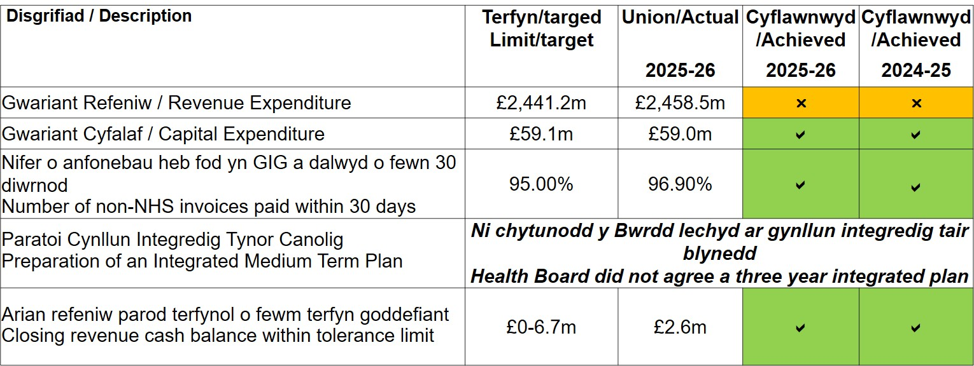
Perfformiad yn erbyn targedau ariannol
Performance against financial targets

Slide 23
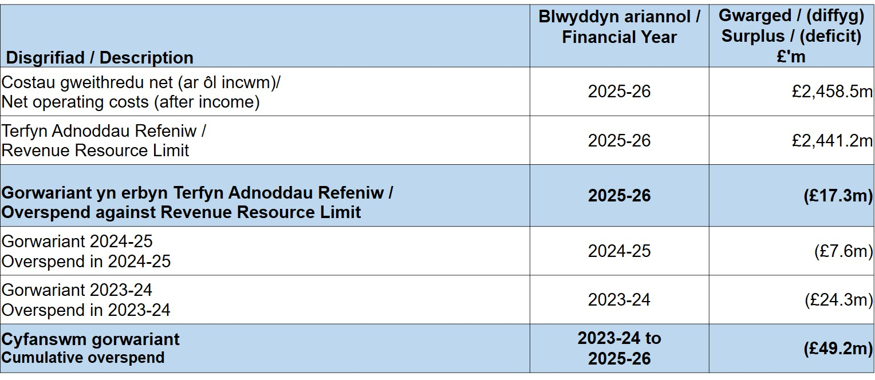
Gwariant Refeniw
Revenue Expenditure

Slide 24
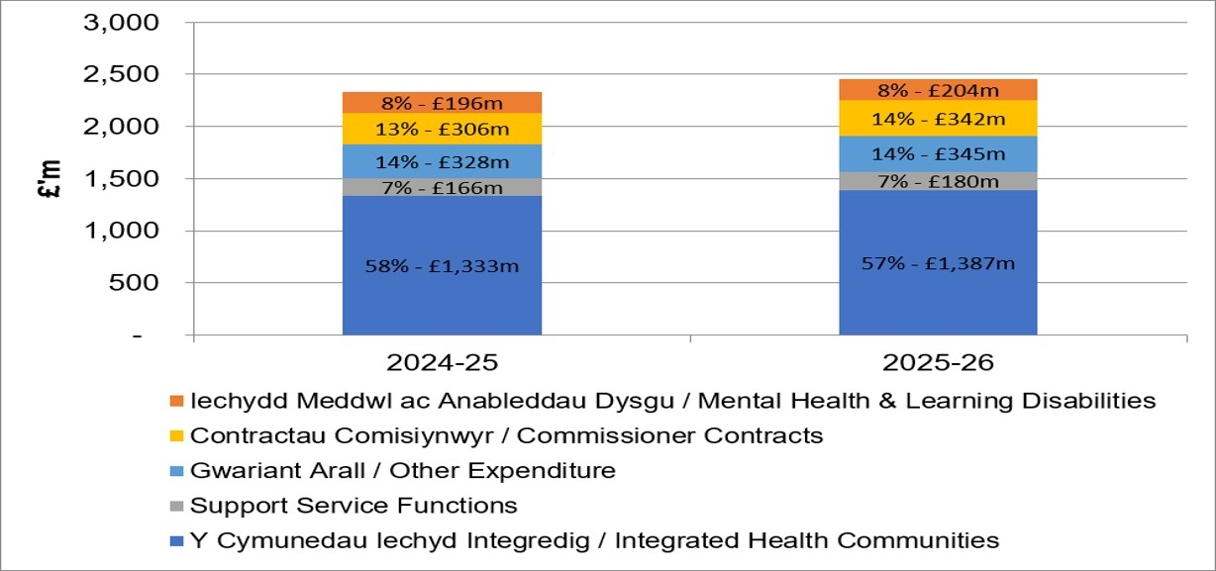
Gwariant fesul Uwch Adran
Expenditure by Division
Neilltuwyd yr adnoddau a dderbyniwyd gan Lywodraeth Cymru yn yr un cyfrannau â’r flwyddyn ariannol flaenorol. Y Cymunedau Iechyd Integredig sydd â’r costau mwyaf.
Resources received from Welsh Government committed in proportion to that of the previous financial years, Integrated Health Communities largest consumers of cost.

Slide 25
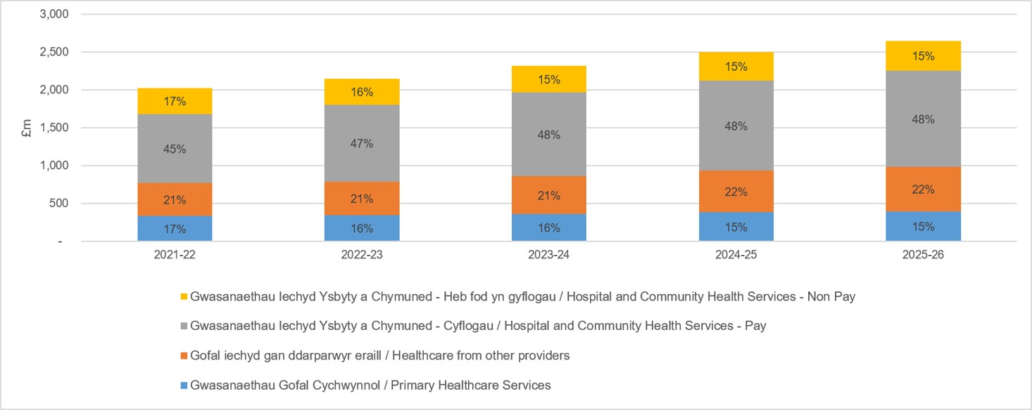
Gwariant fesul Categori
Expenditure by Category
Mae’r graff isod yn dadansoddi gwariant yn erbyn y dyraniad adnoddau refeniw o £2,441.2m a dderbyniwyd gan Lywodraeth Cymru a’r incwm amrywiol o £189.1m
The graph below analyses expenditure against the £2,441.2m revenue resource allocation received from Welsh Government and £189.1m miscellaneous income.

Slide 26
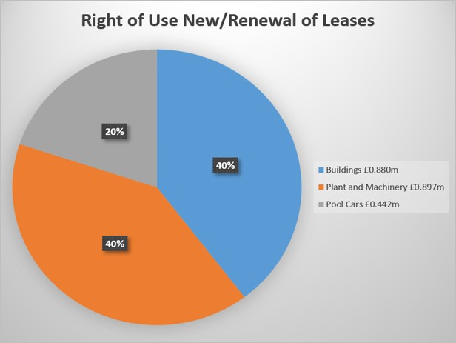
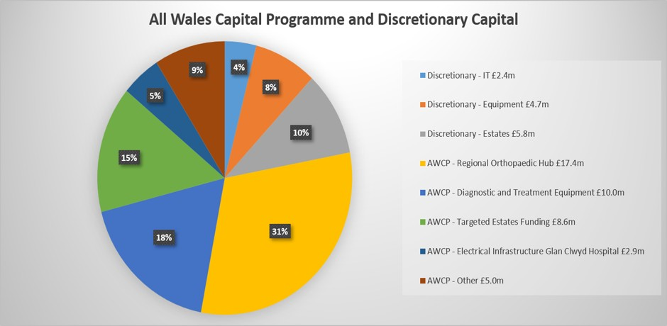
Gwariant Cyfalaf 2025-26
Capital Expenditure 2025-26
Gwariant Cyfalaf / Capital Expenditure | £59.1m
Terfyn Adnoddau Cyfalaf (Cyflawnwyd) / Capital Resource Limit (Achieved) | £0.1m underspend
Adnoddau a neilltuwyd o fewn y dyraniad cyffredinol o adnoddau cyfalaf ar gyfer 2025-26
Resources committed within the overall allocation of capital resource for 2025-26

Slide 27
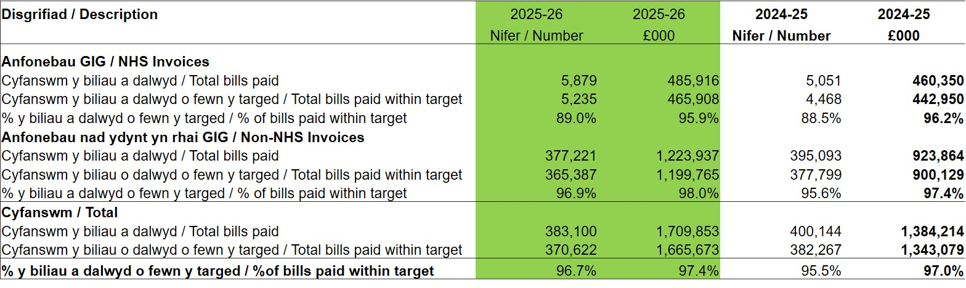
Nifer a Gwerth yr anfonebau a dalwyd o fewn 30 diwrnod
Y targed yw talu cyflenwyr o fewn 30 diwrnod i’r anfonebau.
Number & Value of invoices paid within 30 days
Target is to pay suppliers within 30 days of invoice
Talodd y Bwrdd Iechyd y rhan fwyaf o’r anfonebau o fewn 30 diwrnod, gan ragori ar y targed o 95%.
The Health Board paid the majority of invoices within 30 days, exceeding the 95% target measure.

Slide 28
Crynodeb a Chasgliad 2025-26
• Cyflwynodd y Bwrdd Iechyd gyfrifon drafft a therfynol i Lywodraeth Cymru, gan adrodd am ddiffyg o £17.3m;
• Cyflwynwyd yn unol â’r amserlen cenedlaethol
• Archwiliwyd y cyfrifon gan Archwilio Cymru
• Barn ddiamod ‘Sêl Bendith’
• Dim newid o’r drafft i’r cyflwyniad terfynol
• Barn reoleiddio amodol ‘dyletswydd ariannol allweddol’
• Cyflawni’r terfynau ariannol (gwariant yn is na’r terfyn)
• Talwyd dros 95% o anfonebau nad ydynt yn anfonebau GIG o fewn 30 diwrnod yn ystod 2025-26
Summary & Conclusion 2025-26
Health Board submitted draft and final accounts to Welsh Government, reporting a £17.3m deficit;
  Submitted to national timetable
  Accounts audited by Audit Wales
  Unqualified opinion ‘Clean Bill of Health’
  No change from draft to final submission
  Regulatory opinion qualified ‘key financial duty’
  Capital limits achieved (expenditure below limit)
  Over 95% of Non-NHS invoices paid within 30 days during 2025-26

Slide 29
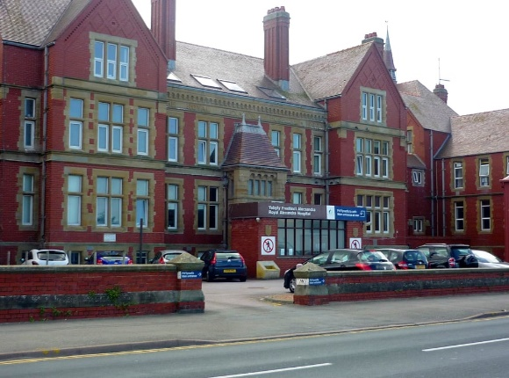
Prosiect Ysbyty Brenhinol Alexandra (RAH): Cam 1
Royal Alexandra Hospital (RAH) Project: Phase 1
Crynodeb ar gyfer Cyfarfod Cyffredinol Blynyddol PBC
Briefing for the BCU Annual General Meeting
29 Gorffennaf/July 2026

Slide 30
Cefndir
Background
Mae gan y prosiect hanes hir yn y Bwrdd Iechyd, o'r SOC yn 2013 a oedd wedi'i wreiddio yn “Mae Gofal Iechyd yng Ngogledd Cymru yn Newid” i'r fersiwn ddiweddaraf o'r Achos Busnes Llawn a gyflwynwyd yn 2021.
Mae disgwyliadau uchel ynghylch darpariaeth a siom mewn perthynas ag oedi canfyddedig. Mae enw da BIPBC dan bwysau gan wleidyddion a'r cyfryngau.
Yr her gan Lywodraeth Cymru fu cyflwyno cynnig mwy fforddiadwy sy'n dal i gyflawni'r rhan fwyaf o'r manteision.
Cyflwynwyd Arfarniad Opsiynau ym mis Ebrill 2024 a ddangosodd gwmpas llai a allai gyflawni’r manteision. Amcangyfrifwyd cost cyfalaf o £60m.
The project has a long history in the Health Board, from the SOC in 2013 rooted in “HealthCare In North Wales is Changing” to the last version of the FBC submitted in 2021
There is a high level of expectation around delivery and disappointment in relation to perceived delays. BCUHB’s reputation is under pressure from politicians and the media
The challenge from WG has been to deliver a more affordable proposal which still achieves the majority of the benefits
An Option Appraisal was submitted in April 2024 which
demonstrated a reduced scope that could achieve benefits. This was estimated at a capital cost of £60m

Slide 31
Amcanion Buddsoddiad Strategol
Strategic Investment Objectives
Darparu gwasanaethau diogel a chynaliadwy i fodloni anghenion y boblogaeth leol
Datblygu mwy ar wasanaethau gofal sylfaenol a chymunedol amlasiantaeth ac integredig yn yr ardal
Cynyddu’r ystod o wasanaethau lleol, gan leihau’r ddibyniaeth ar yr Ysbyty Cyffredinol Dosbarth
Darparu gwasanaethau mewn amgylchedd sy’n addas i’r diben
Symud gofal yn agosach at gartrefi pobl
To provide safe and sustainable services meeting the needs of the local population
To further develop multi-agency, integrated, primary and community care services in the area
To increase the range of local services, thereby reducing the reliance on the DGH
To deliver services in an environment which is fit for purpose
To move care closer to people’s homes

Slide 32
Cwmpas Cam 1
Phase 1 Scope
Cyfleuster Ailalluogi Cymunedol – gwelyau “Barod i Fynd Adref”
Uned Mân Anafiadau ac Anhwylderau (MIAU)
Radioleg – wedi’i adleoli a’i ehangu (o Adeilad Presennol YBA)
Gwasanaethau Deintyddol – wedi’i adleoli a’i ehangu (o Adeilad Edith Vizard, ar safle YBA)
Y Dderbynfa, y Caffi, a’r Hwb Trydydd Sector
Ardaloedd Gorffwys Staff, Ardaloedd Gorffwys Cleifion, a Lles
Community Reablement Facility – “Ready to Go Home” beds
Minor Injuries and Ailments Unit (MIAU)
Radiology – relocated and expanded (from RAH Existing Building)
Dental Services – relocated and expanded (from Edith Vizard Building, on RAH site)
Reception, Café and Third Sector Hub
Staff Rest Areas, Patient Rest Areas, and welfare

Slide 33
Buddion
Benefits
Buddsoddi mewn iechyd a lles ar gyfer y gymuned hon
Investment in health and well-being for this community
Cynnal darpariaeth y gwasanaethau yn agosach at adref
Sustain service delivery closer to home
Datblygu gwasanaethau integredig a chryfhau ein CRT
Develops integrated services and strengthens our CRT
£3.3 miliwn o fuddion economaidd â gwerth ariannol gan gynnwys swyddi a llif cleifion
£3.3m in monetised economic benefits incl. jobs and bed flow
220 o gleifion y flwyddyn mewn cyfleuster Ailalluogi, gan arbed 4,500 o ddiwrnodau gwely
220 patients pa in Reablement facility, saving 4,500 bed days
Roedd modd gweld 16% o'r holl gleifion Adran Argyfwng yn Ysbyty Glan Clwyd
16% of all ED patients at Ysbyty Glan Clwyd could be seen
2,000 o gleifion o leoliadau cymunedol eraill i'r MIAU
2000 patients from other community settings to the MIAU

Slide 34

Gweithgarwch | Amserlen
Dechrau defnyddio maes parcio gorlwytho y Pafiliwn | Gorffennaf 2026
Sefydlu cyfansawdd y safle a’r gwaith paratoi | Gorffennaf – Awst 2026
Dechrau’r gwaith ar yr adeilad newydd | Awst 2026
Dymchwel/Canolfan Ynni | Medi – Rhagfyr 2026
Gweithiau allanol RAH (ffenestri, gwaith maen, ac ati.) | Dechrau Chwarter 3 2026/27
Gosod adeilad modiwlaidd (uned glinigol newydd) | Ch3 2026/27 – Ch3 2027/28
Claf Cyntaf | Chwarter 3 2027
Dyddiadau Allweddol
Activity | Timescale
Start use of overflow car park at Pavilion | July 2026
Establish site compound and preparatory works | July – Augus 2026
Commence work on new building | August 2026
Demolition/Energy Centre | Sept. – Dec. 2026
RAH exterior works (windows, masonry etc.) | Start Quarter 3 2026/27
Install and fit out modular building (new clinical unit) | Q3 2026/27 – Q3 2027/28
First Patient | Quarter 3 2027
Key Dates

Slide 35
Parcio Car
Car Parking
Bydd yr wythnosau nesaf yn brysur ar y safle, ac rydym yn gwerthfawrogi unrhyw gymorth gyda pharcio ceir yn fawr
Ers dydd Llun, 20 Gorffennaf, disgwylir i’r rhan fwyaf o staff barcio ym Mhafiliwn Y Rhyl
Mae'r Prosiect yn defnyddio system newydd sydd wedi’i ddarparu gan ein ffrindiau yng Nghyngor Sir Ddinbych
Mae parcio am ddim i gleifion a staff
Mae 14 o leoedd parcio hygyrch yn aros ar y prif safle
Mae’r drefn ar gyfer staff a chleifion wedi’i chyhoeddi mewn llythyrau, gan gynnwys ar gyfer deiliaid Bathodynnau Glas.
The next few weeks will become busy at site and support for car parking is greatly appreciated
Since Monday 20th July most staff have been expected to park at the Rhyl Pavillion
The Project is using a new system provided by our friends in Denbighshire County Council
Parking is free for patients and staff
14 bays at the main site remain for accessible parking.
Procedures for staff and patient letters have been issued including for Blue Badge holders

Slide 36
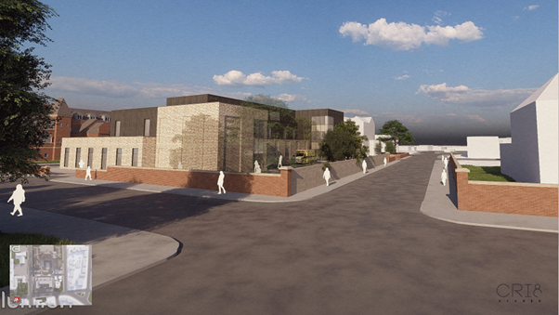

Slide 37
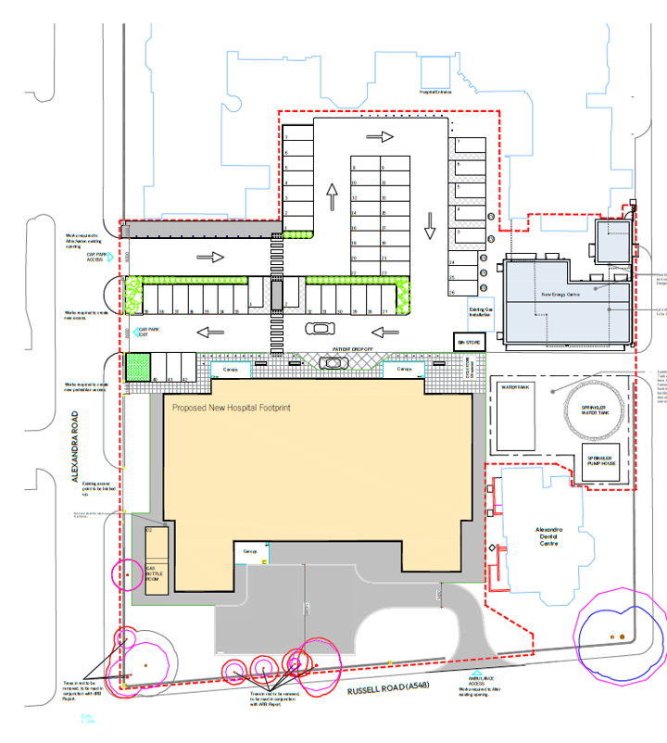
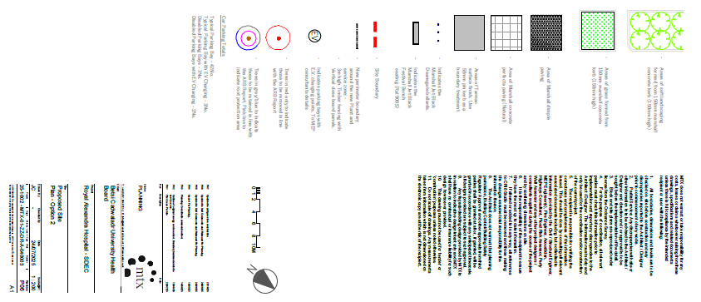

Slide 38
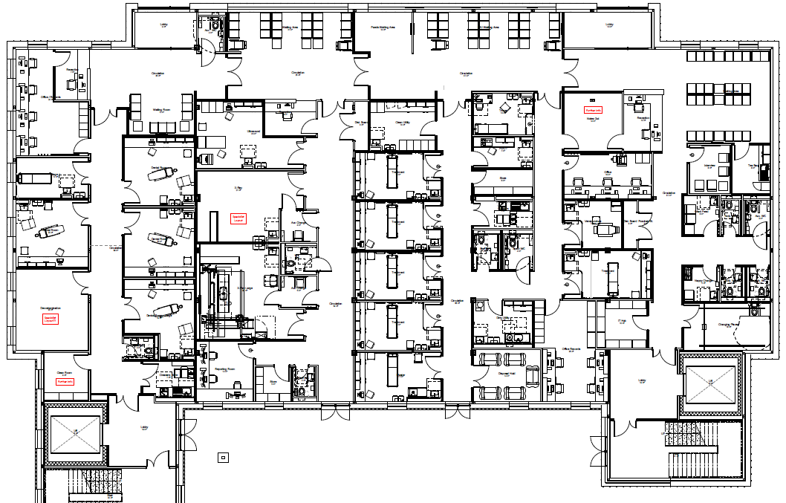
Dental
Radiology
MIAU

Slide 39
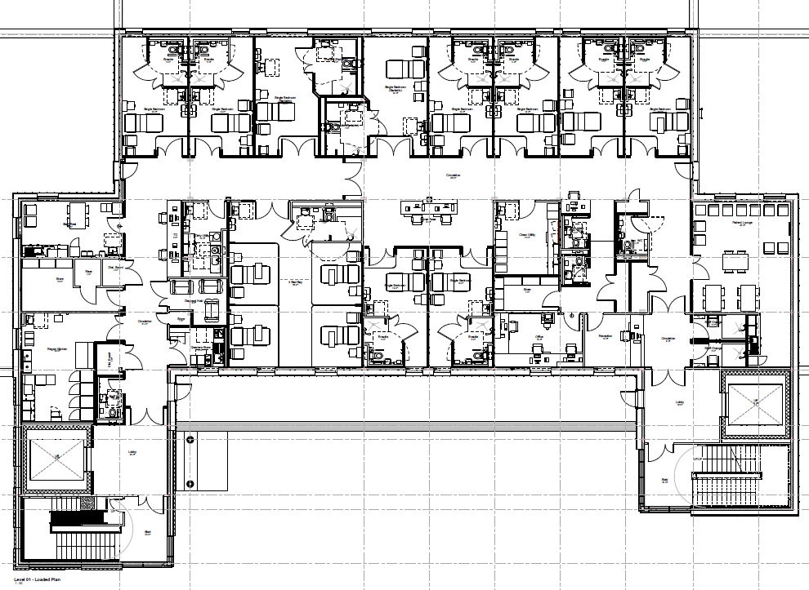

Slide 40
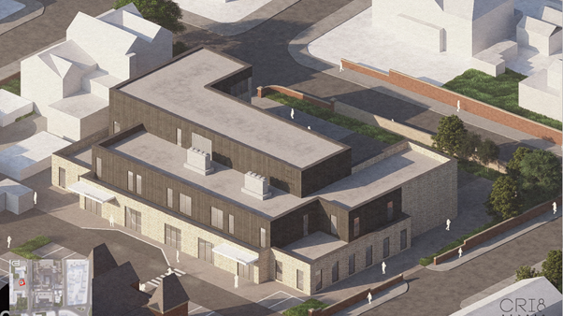

Slide 41
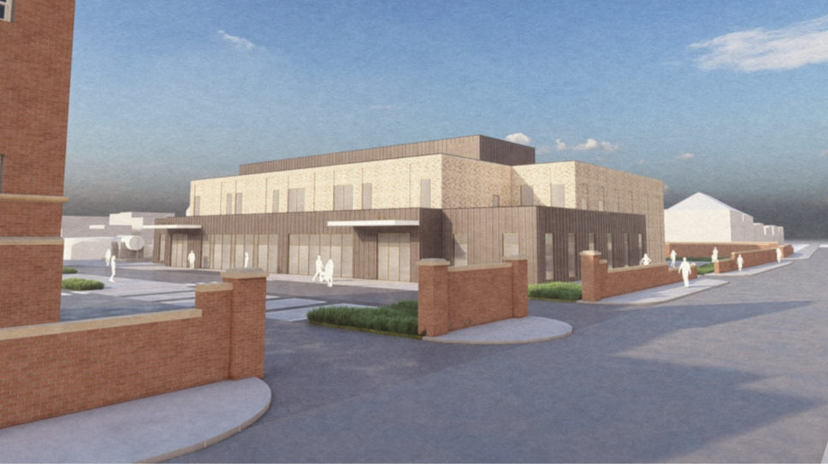

Slide 42
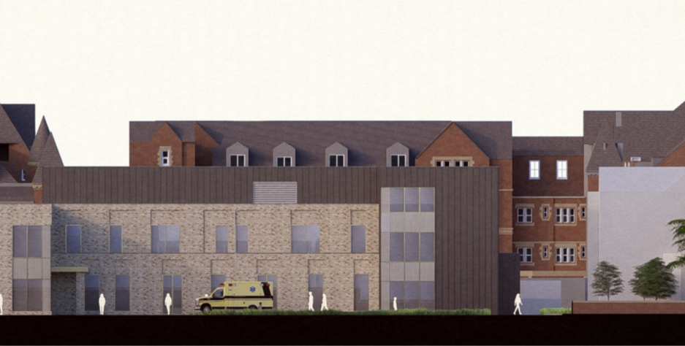

Slide 43
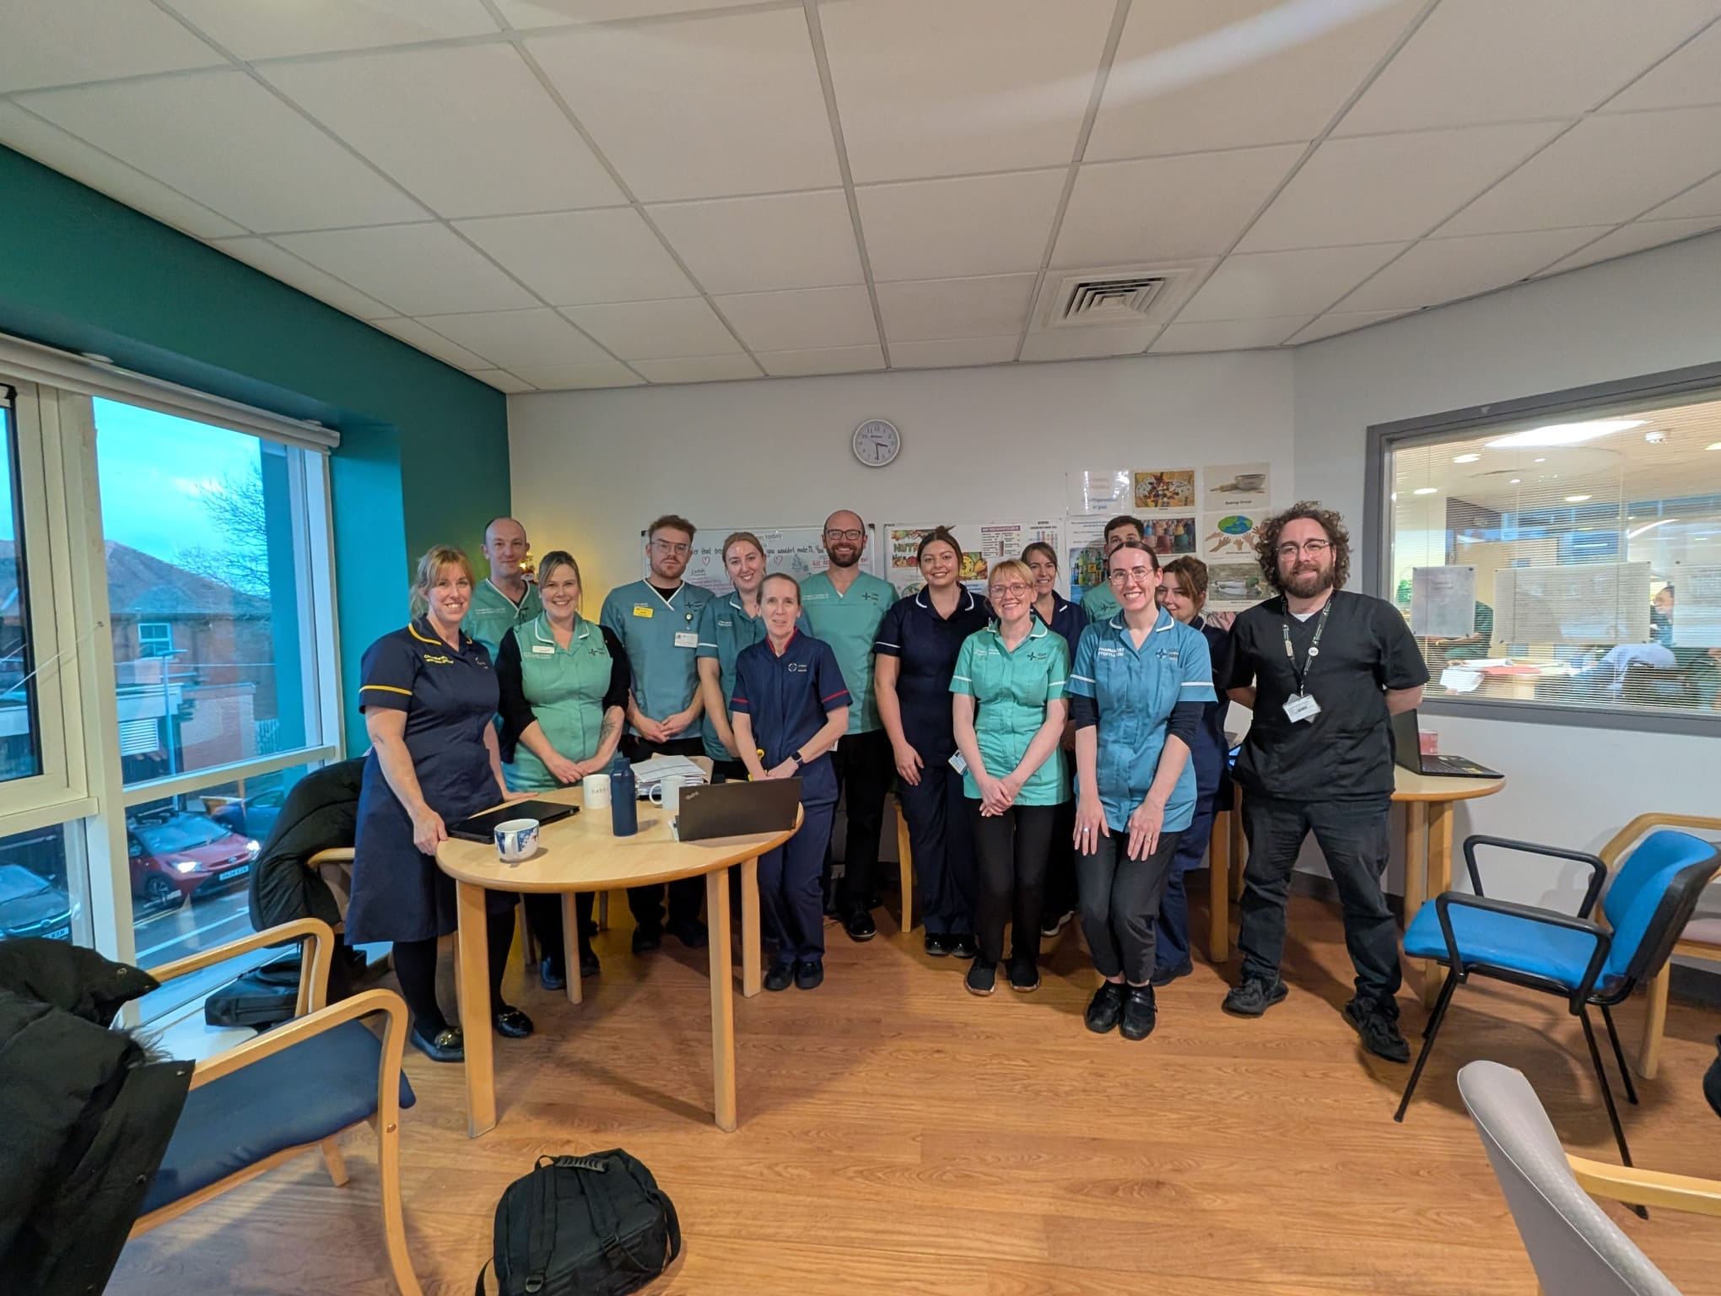
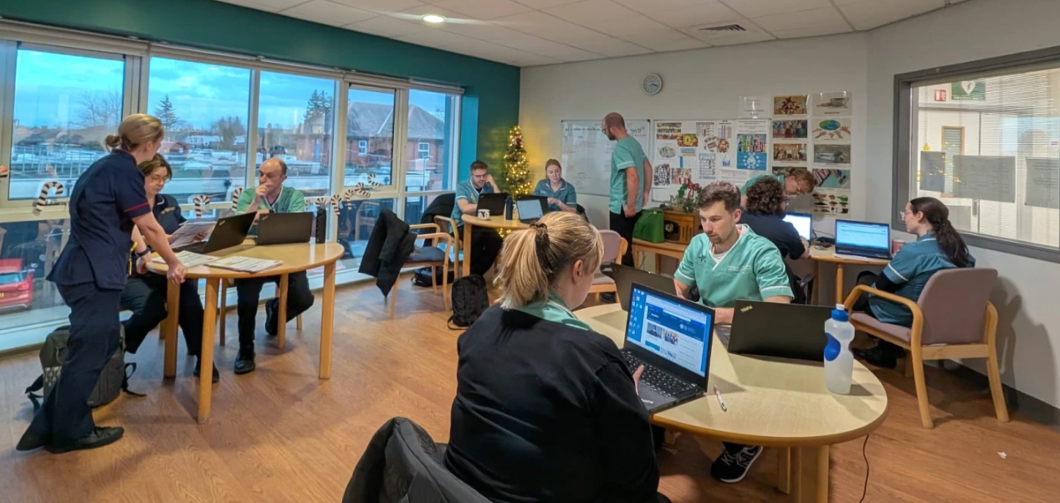
ePMA
System Electronig a Rhagnodi Meddyginiaethau
Wedi ei gyflwyno gan:
Jane Brady, Prif Swyddog Gwybodaeth Nyrsio
Kate Davies, Nyrs Arweiniol Gwybodeg
(ar ran tÎm ePMA)
ePMA
Electronic Prescribing and Medications Administration
Presented by:
Jane Brady, Chief Nursing Information Officer
Kate Davies, Lead Nurse Informatics
(on behalf of the ePMA Team)

Slide 44


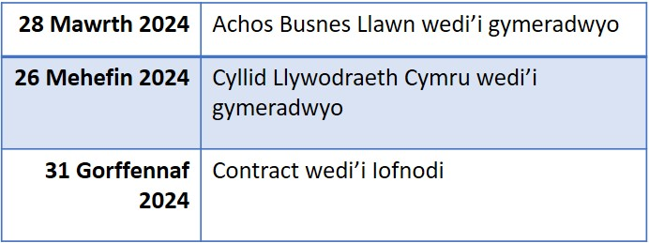
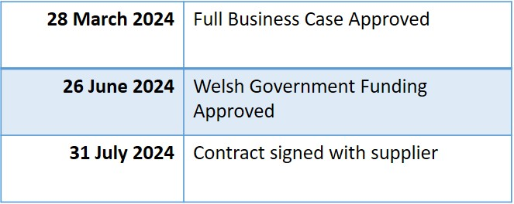

EIN TAITH MYND YN FYW
OUR GO-LIVE JOURNEY
Camau Allweddol
Key Milestones
Heddfan 10 Rhagfyr 2025
Heddfan 10 December 2025
Dwyrain 10 Ionawr 2026
East 10 January 2026
Gorllewin 7 Chwefror 2026
West 7 February 2026
Canolog 7 Mawrth 2026
Central 7 March 2026

Slide 45

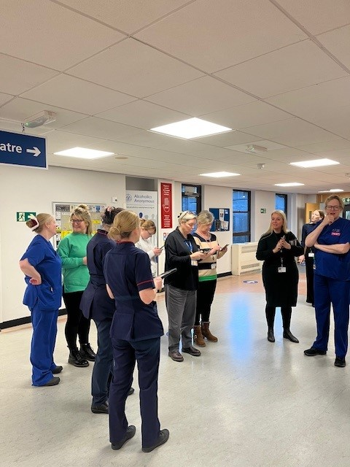
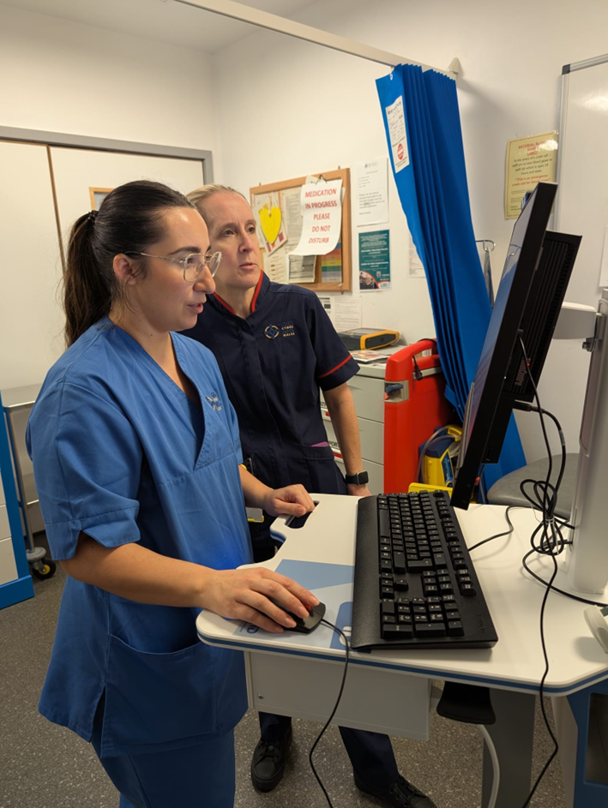
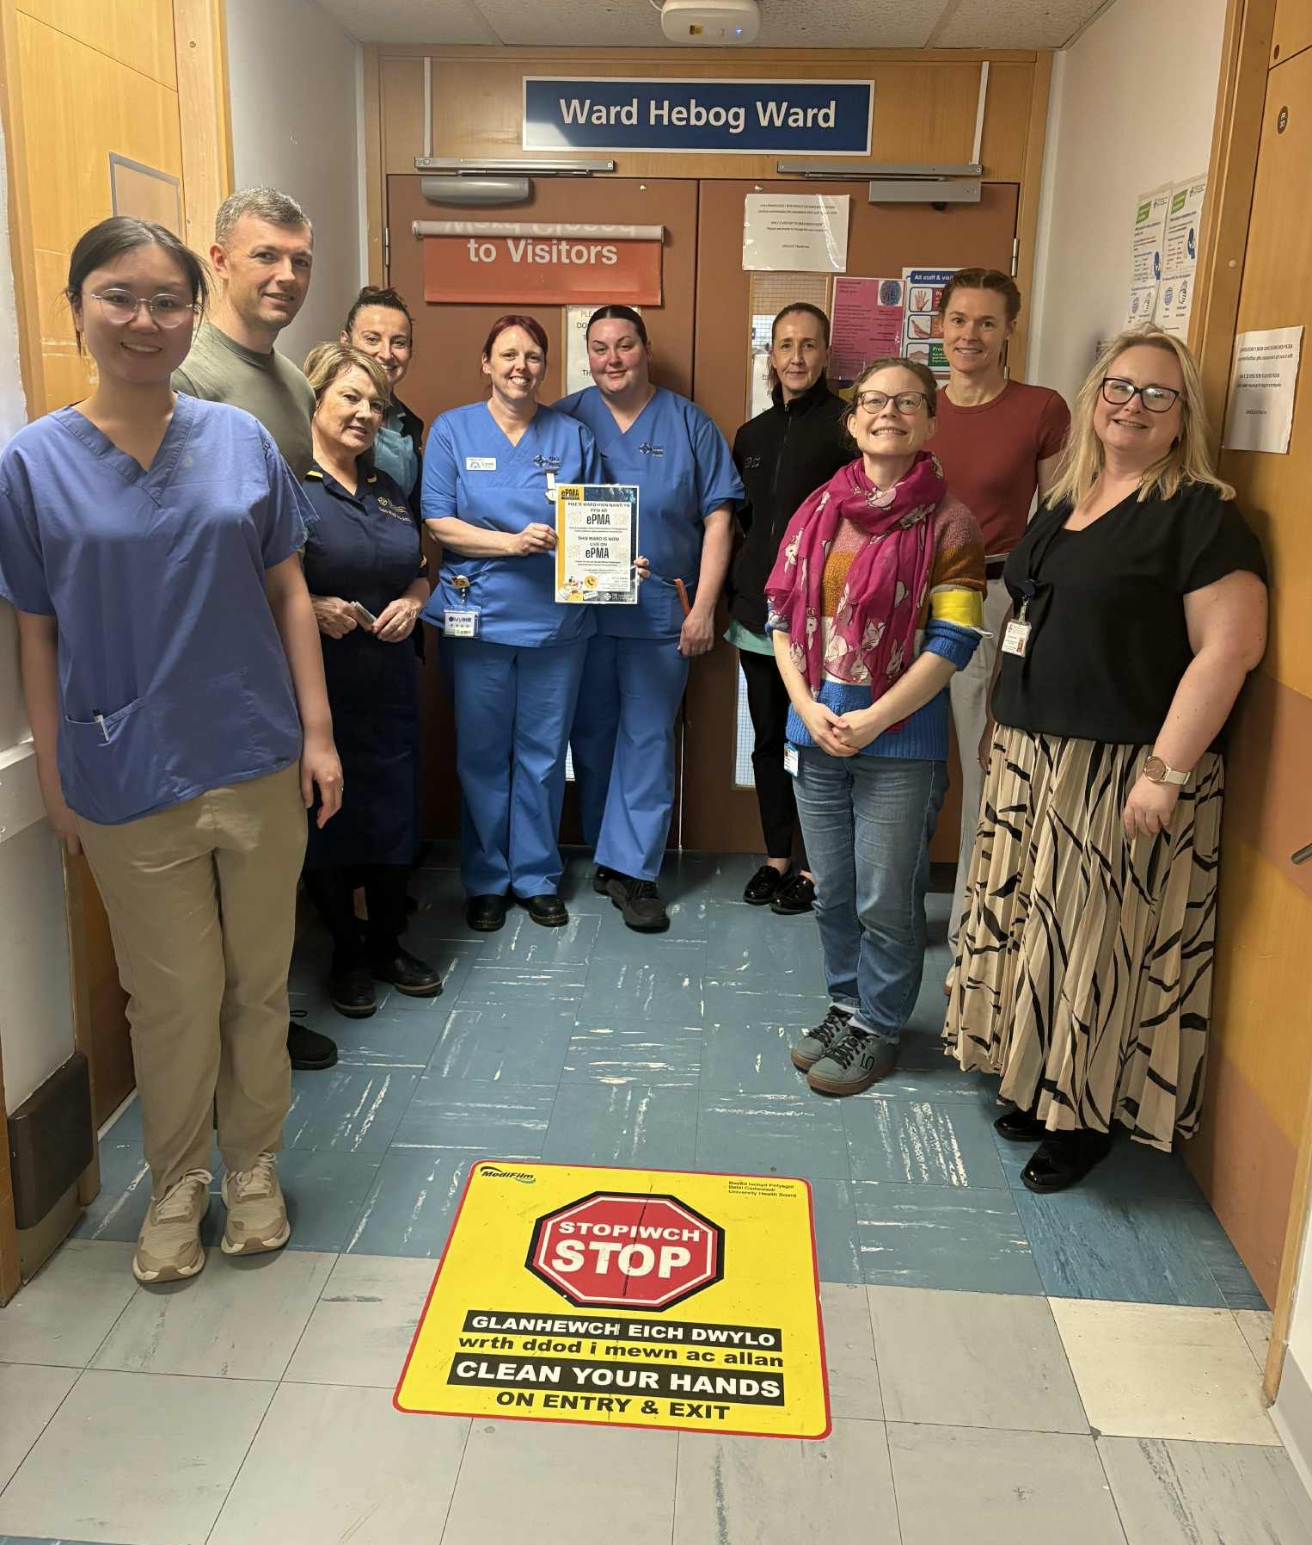
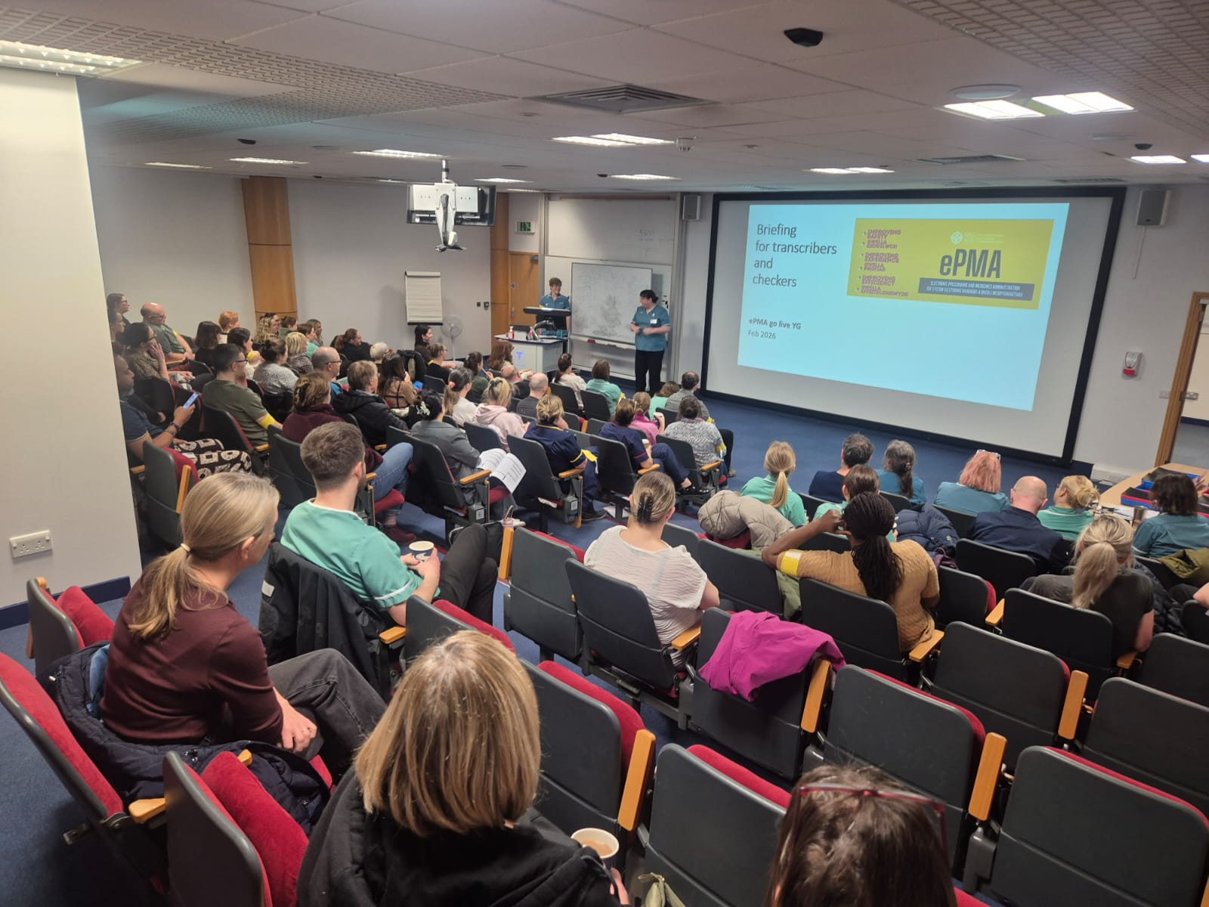
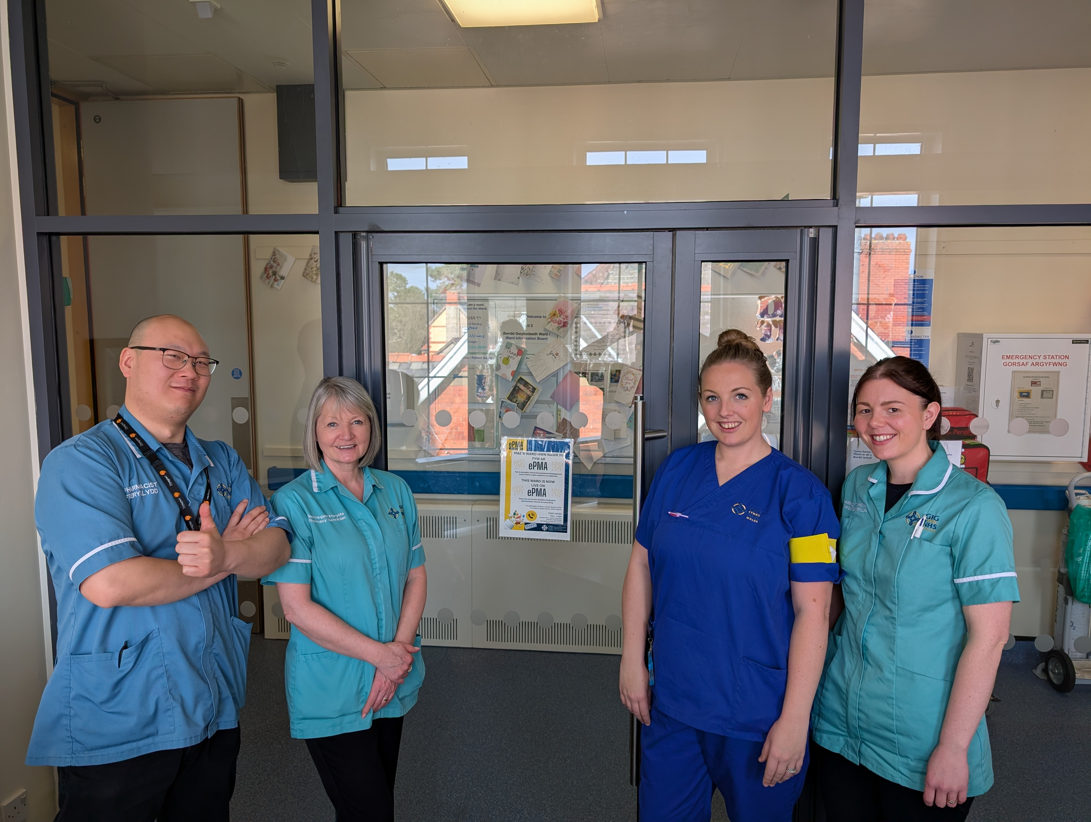
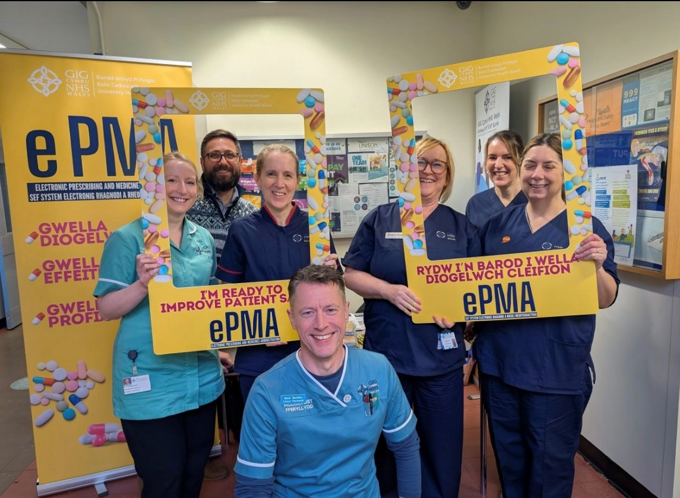
BETH WNAETHOM GYFLAWNI
WHAT WE ACHIEVED
Yn fyw ar draws ardaloedd cleifion mewnol acÍwt, cymunedol ac iechyd meddwl
Live across acute, community and mental health inpatient areas
2141 Beds & 106 Wards
2141 Gwelyau & 106 Wardiau
Supporting over 140 clinical areas
Cefnogi dros 140 o feysydd clinigol​
Used by over 7,000 clinical staff
Ei ddefnyddio gan dros 7,000 o staff clinigol
More than 43,000 patients supported since implementation
Mwy na 43,000 o gleifion wedi cael ei gefnogi ers y gweithrediad

Slide 46
BLE RYDYM NI NAWR
WHERE WE ARE NOW
Parhau i ddatblygu integreiddiadau
Continued deployment of integrations
Wedi Cynnwys adborth defnyddwr yn yr adroddiad Gwersi a Dysgwyd
User feedback incorporated into the Lessons Learnt report
Adolygiad Ôl-Gweithredu a Cau’r Rhaglen ar y trywydd iawn ar gyfer Gorffennaf 2026
Post-Implementation Review & Programme Closure on track for July 2026
Cylchlythyr ePMA chwarterol ar wefan BetsiNet
Quarterly ePMA newsletters on the ePMA BetsiNet site
Ymweliadau safle Sylfaenol a Chymunedol yn parhau
Acute & Community site visits ongoing
Cynllunio gyda BetterMeds ar y gweill ar gyfer uwchraddio’r system diwedd 2026
Planning with BetterMeds underway for the system upgrade in late 2026

Slide 47
TROSOLWG BUDDION ePMA (1)
Cynnydd Hyd Yma (C1 26/27)
ePMA BENEFITS OVERVIEW (1)
Progress To Date (Q1 26/27)
Cynaliadwyedd
Gwella casglu data, adrodd a llywodraethu clinigol. 28.9 o goed wedi'u achub hyd yma
Sustainability
Reducing paper usage and supporting our environmental commitments. 28.9 trees saved to date
Hyfforddiant Staff
Dros 7,000 o staff wedi'u hyfforddi i gefnogi gweithrediad diogel ar draws y Bwrdd Iechyd. 78% Adborth Cadarnhaol gan Staff
Staff Training
Over 7,000 staff trained to support safe implementation across the Health Board. 78% Positive Staff Feedback
Rheoli Gwrthficrobau (AMS)
Cofnodi arwyddion gwrthficrobaidd yn gyson a gallu gefnogi adolygiad a monitro rhagnodi gwrthfiotigau yn well.
Antimicrobial Stewardship (AMS)
Consistent recording of antimicrobial indications and improved ability to support review and monitoring of antibiotic prescribing.

Slide 48
TROSOLWG BUDDION ePMA (2)
Cynnydd Hyd Yma (C1 26/27)
ePMA BENEFITS OVERVIEW (2)
Progress To Date (Q1 26/27)
Gwella Diogelwch Cleifion
Dileu yn syth unrhyw bresgripsiwn claf mewnol beth na ellir ei ddarllen, lleihau'r risg o gamgymeriad meddyginiaeth a chefnogi ysgrifennu presgripsiwn mwy diogel a safonol.
Improved Patient Safety
Immediate elimination of illegible inpatient prescriptions, reducing the risk of medication errors and supporting safer, standardised prescribing.
Data Quality and Governance
Improved medicines data capture, reporting and audit capability to support clinical governance and improvement work.
Ansawdd Data a Llywodraethu
Gwella y gallu i gasglu, adrodd ac archwilio data meddyginiaethau i gefnogi gwaith llywodraethu clinigol a gwelliant.
Effeithlonrwydd Gweithredol
Yn lleihau dyblygu presgripsiynau, yn darparu mynediad cynt i hanes gweinyddiaeth meddyginiaeth, yn lleihau'r amser a dreulir yn egluro ysgrifen llaw, ac yn cefnogi gwneud penderfyniadau clinigol aml ddisgyblaethol gan ryddhau staff clinigol i dreulio mwy o amser yn darparu gofal uniongyrchol i gleifion.
Operational Efficiency
Reduces prescribing duplication, provides quicker access to medication administration history, minimises time spent clarifying handwriting, and supports multidisciplinary clinical decision-making—freeing clinical staff to spend more time delivering direct patient care.

Slide 49
BLE RYDYM NI NAWR
WHERE WE ARE NOW
Cryfhau datblygiad staff gyda adnoddau
Hyfforddi gwell a chanllawiau arfer gorau'r system
Strengthen staff development with improved training resources and system best practice guidance
Ehangu i wasanaethau cleifion allanol ychwanegol ac arbenigeddau eraill
Expand to additional outpatient services and other specialties
Datblygu'r cynllun ffordd ar gyfer uwchraddiadau BetterMeds yn y dyfodol
Develop the roadmap for future BetterMeds upgrades
Cydweithio gyda’r cyflenwr system i
Weithredu gwelliannau wedi’u hysbysu gan adborth staff
Collaborate with the system supplier to implement improvements informed by staff feedback

